Slide 1

Credit Score Predictive Modeling
Comparing the parametric, non-parametric and neural networks credit scoring techniques.
Nitin Yadav
M.Sc in Computing
Dublin City University

Slide 2
Presentation Outline
Introduction
Literature Review
Research Methodology
Results and Discussions
Conclusions and Future Work

Slide 3

Introduction
Financial institutions prone to several risks nowadays due to introduction of new financial services.
Risk portfolio assessment crucial to minimize the associated losses.
Tools and prediction systems required to develop scales for measuring risks.

Slide 4

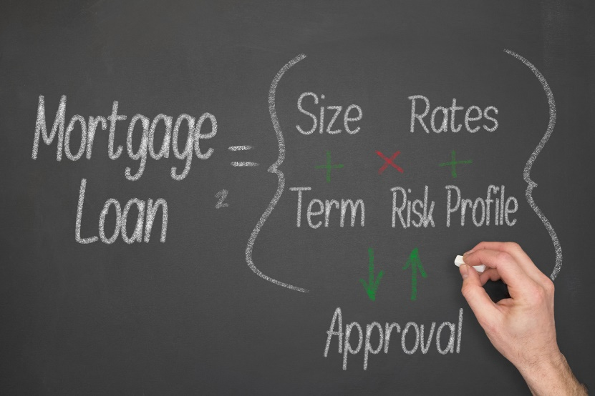
Introduction
Loans and credits- one of widely popular financial services.
Amounts of credit range from a few thousand euros to hundreds of millions.
Credit risk assessment forms a major portion of the overall risk assessment and performed using credit scoring models.

Slide 5



Introduction
Statistical techniques and machine learning implemented to build credit scoring models.
Decision factors/attributes include demographic details, financial status of application, previous payment records etc.
Different statistical techniques offer varying efficiencies, the final selection based on the available dataset.

Slide 6
Literature Review: Introduction to Credit Scoring
Credit scoring- A standardized process of analysing and classifying the payment behavior of customers whether individuals or companies (Scharwz and Arminger, 2006).
Based upon statistical techniques and used to establish the credit trustworthiness.
Enhances the risk assessment process by identifying the driving factors causing the default.
Makes use of only statistically significant variables to boost the efficiency of the entire process.
Successfully removes the bias involved in conventional judgemental methods.

Slide 7
Literature Review Models for Credit Score Prediction
Parametric Techniques
Non-Parametric Techniques
Machine Learning
Identify the relationship between a response variable and one or more independent/explanatory variables.
Techniques include regression methods, discriminant analysis etc.
A few assume standardized distributions for the explanatory variables.
Utilize tree classification of records to evaluate all the possible splits. Some utilize patterns to establish the links with unknown samples.
Simple and straightforward classification rules , allows models to be trained quite fast.
Techniques includes decision trees, KNN etc.
Computer programs trained using trial and error, training allows to distinguish variables.
Few employ genetic operations to transform a dataset according to the fitness value.
Techniques include neural networks, genetic programming etc.
Models developed based on parametric and non-parametric statistical techniques and machine learning algorithms.

Slide 8
Literature Review Performance Evaluation Criteria
Metrics such as confusion matrix, mean square error (MSE), root mean square error (RMSE), receiver operating characteristic (ROC) curve etc. used for evaluation of credit scoring models.
Widely used ones- confusion matrix and ROC curve.
Confusion matrix
Measures proportion of correctly classified cases as good and bad.
Matrix represents the combination of actual and predicted observations.
Accuracy is obtained using this metric
ROC curve
2D curve representing the proportion of bad cases classified as bad and good cases classified as good at all cut-off score values.
A linear straight line from origin represents a bad model, a good model covers the region above that and a perfect model stays at the top ends of the curve.

Slide 9
Research Methodology Data Description
Dataset from University of California Irvine (UCI) machine learning repository.
Credit data from a Taiwanese bank with 30,000 observations.
22 explanatory variables and 1 response variable.
Each variables selected for analysis as values appear to be quite random.

Slide 10
Research Methodology Attributes in the Dataset
X1: Amount of the given credit (NT dollar): it includes both the individual consumer credit and his/her family (supplementary) credit.
X2: Gender (1 = male; 2 = female).
X3: Education (1 = graduate school; 2 = university; 3 = high school; 4 = others).
X4: Marital status (1 = married; 2 = single; 3 = others).
X5: Age (year).
X6–X11: History of past payment. We tracked the past monthly payment records (from April to September 2005) as follows: X6 = the repayment status in September 2005; X7 = the repayment status in August 2005; ...; X11 = the repayment status in April 2005. The measurement scale for the repayment status is: 1 = pay duly; 1 = payment delay for one month; 2 = payment delay for two months; ...; 8 = payment delay for eight months; 9 = payment delay for nine months and above.
X12–X17: Amount of bill statement (NT dollar). X12 = amount of bill statement in September 2005; X13 = amount of bill statement in August 2005; ...; X17 = amount of bill statement in April 2005.
X18–X23: Amount of previous payment (NT dollar). X18 = amount paid in September 2005; X19 = amount paid in August 2005; ...; X23 = amount paid in April 2005.
Y: Default status

Slide 11
Research Methodology Credit Scoring Model Implementation
Model implemented using Python.
Dataset split into train and test data in the 60:40 ratio.
Logistic regression, random forests, decision tree boosting and neral networks selected for comparison.
Confusion matrix and ROC curves used to evaluate the models.

Slide 12
Results and Discussions Data Analysis
Performed to identify the influential attributes from the entire list.
Percentage of defaulters 22.12% enough to draw meaningful conclusions. Dataset with 50-50 distribution of default and no-default would have given an ideal demarcation.
Variables separated as categorical (such as SEX) and numerical (such as BILL AMOUNTS).
Analysis initiated with examining the influence of different explanatory variables on the response variable.

Slide 13
Results and Discussions Relationship Graphs
No. of customers with and without default against two levels of credit amount level

Slide 14
Results and Discussions Relationship Graphs

Slide 15
Results and Discussions Relationship Graphs
No. of customers with and without default classified based on their education status

Slide 16
Results and Discussions Relationship Graphs
No. of customers with and without default classified based on their sex

Slide 17
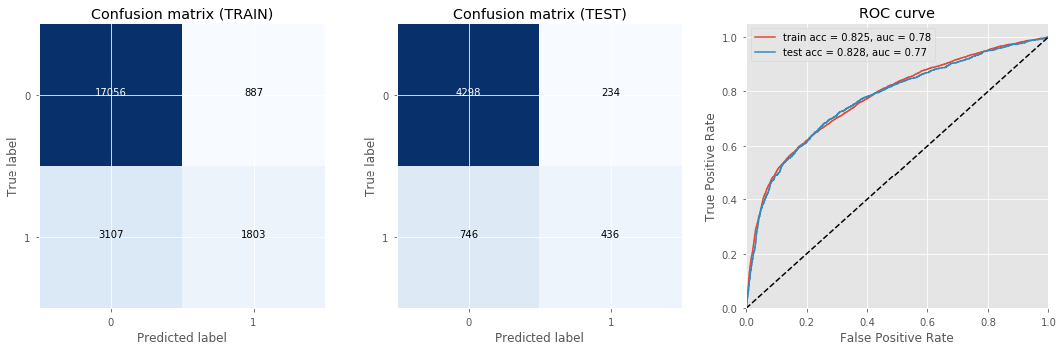
Results and Discussions Confusion Matrix and ROC curve Logistic Regression Model

Slide 18
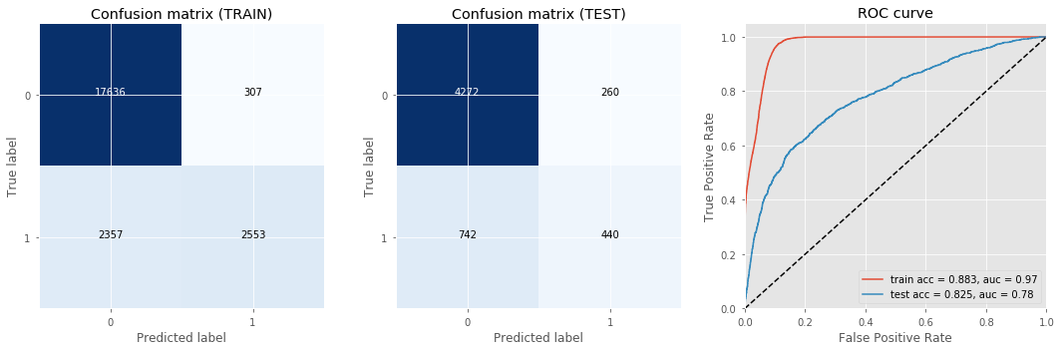
Results and Discussions Confusion Matrix and ROC curve Random Forests Method

Slide 19
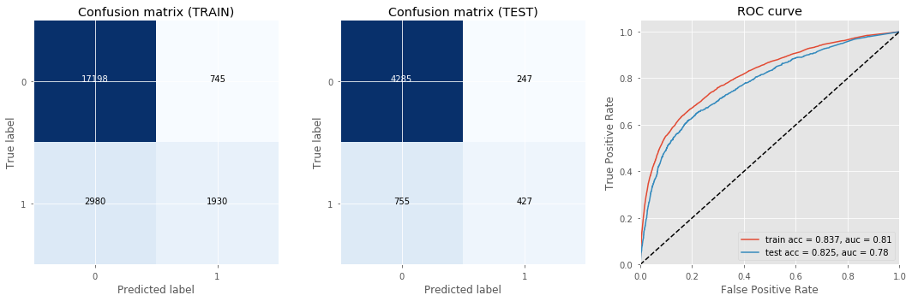
Results and Discussions Confusion Matrix and ROC curve Decision Tree Boosting Method

Slide 20
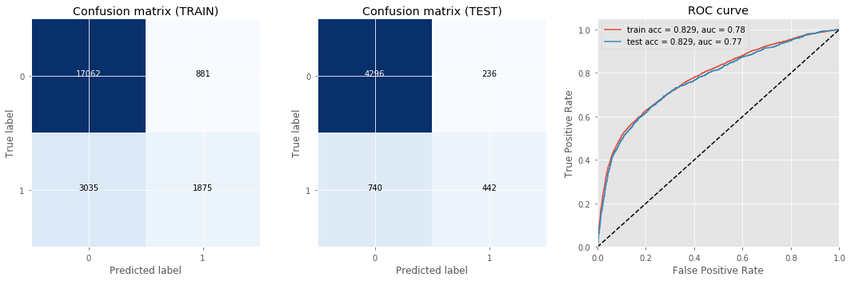
Results and Discussions Confusion Matrix and ROC curve Neural Networks Method

Slide 21
Results and Discussions
Neural networks have the highest efficiency.
Discrepancy exist in train and test accuracies for random forests technique.
Decision tree boosting reduces the existing discrepancy.

Slide 22
Conclusions and Future Work
Comparison of different techniques used in credit scoring applications.
Neural networks achieve a high accuracy although time and resource intensive.
Data analysis crucial in the entire process as uninfluential attributes disregarded from the model.
Numerical variables found to have the highest influence while categorical variables seem to have the least influence.

Slide 23
Conclusions and Future Work
Parametric models possess higher efficiencies than the non-parametric ones.
Overfitting occurs in non-parametric models, which can be eliminated using boosting techniques.
Interdimensional aspects normally neglected in deciding whether or not to grant the loan.
Future work could integrate these aspects to form effective indicators.

Slide 24
Thank You

